Slide 1

K8S BUILD BREAK DEFEND

Slide 2
Agenda
So Much content, “I know we aren’t going to get to all of it”
About Me
Quick Primer
Builder: (Developing / maintaining apps via containers)
Defender: (Container Security)
Breaker: (Common attacks)
Breaker: (Less common attacks)
Wrap-Up
Questions
Extra Content (If we have time)

Slide 3
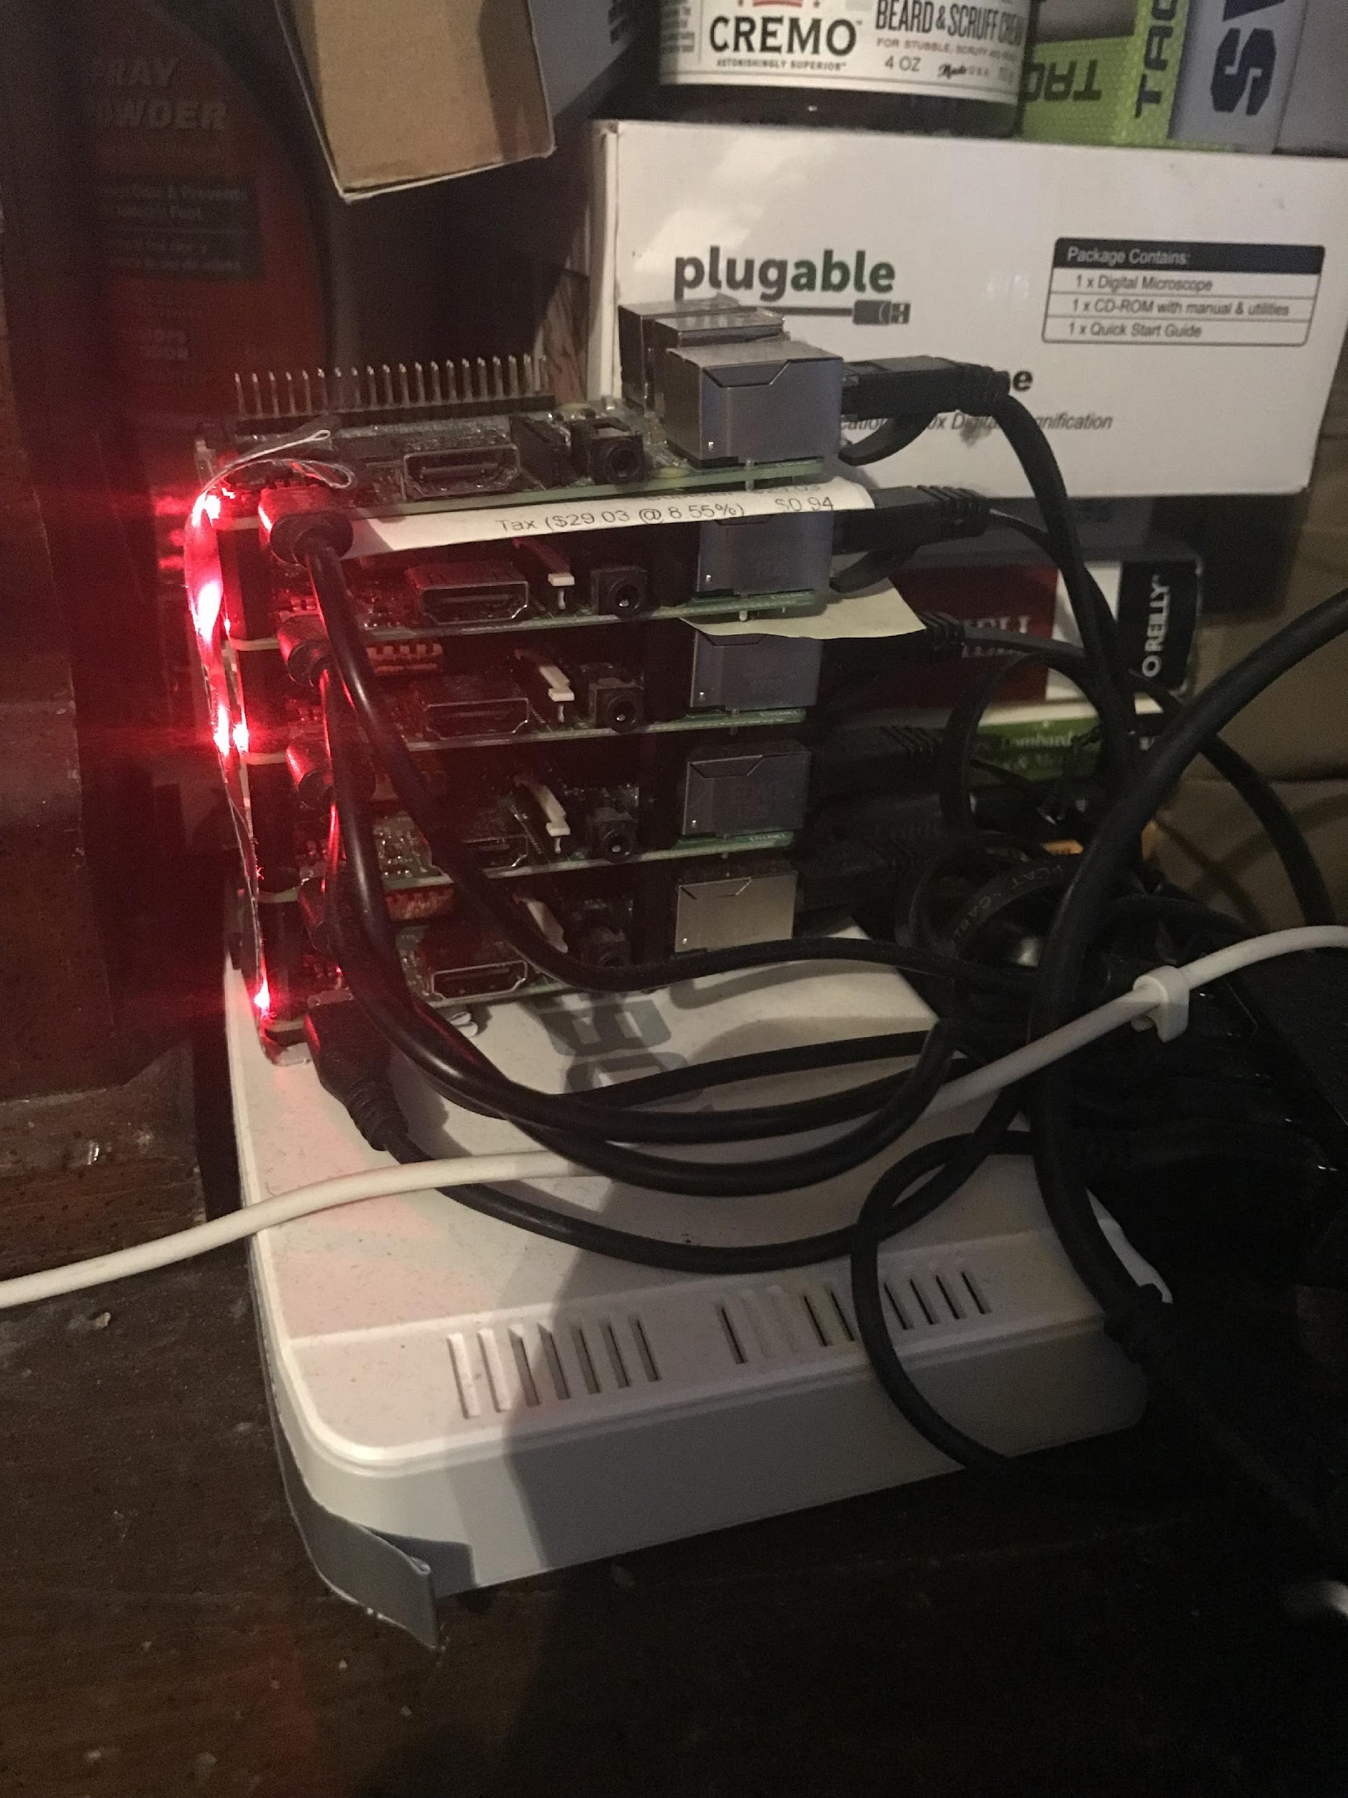
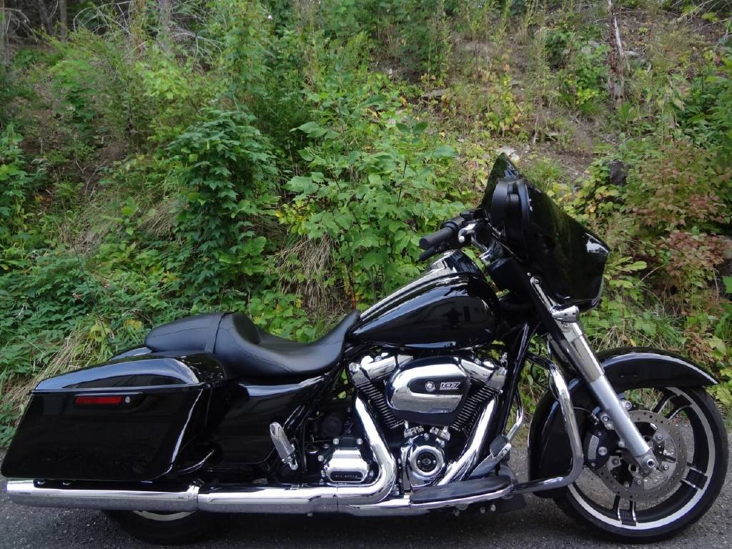
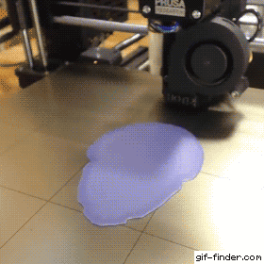



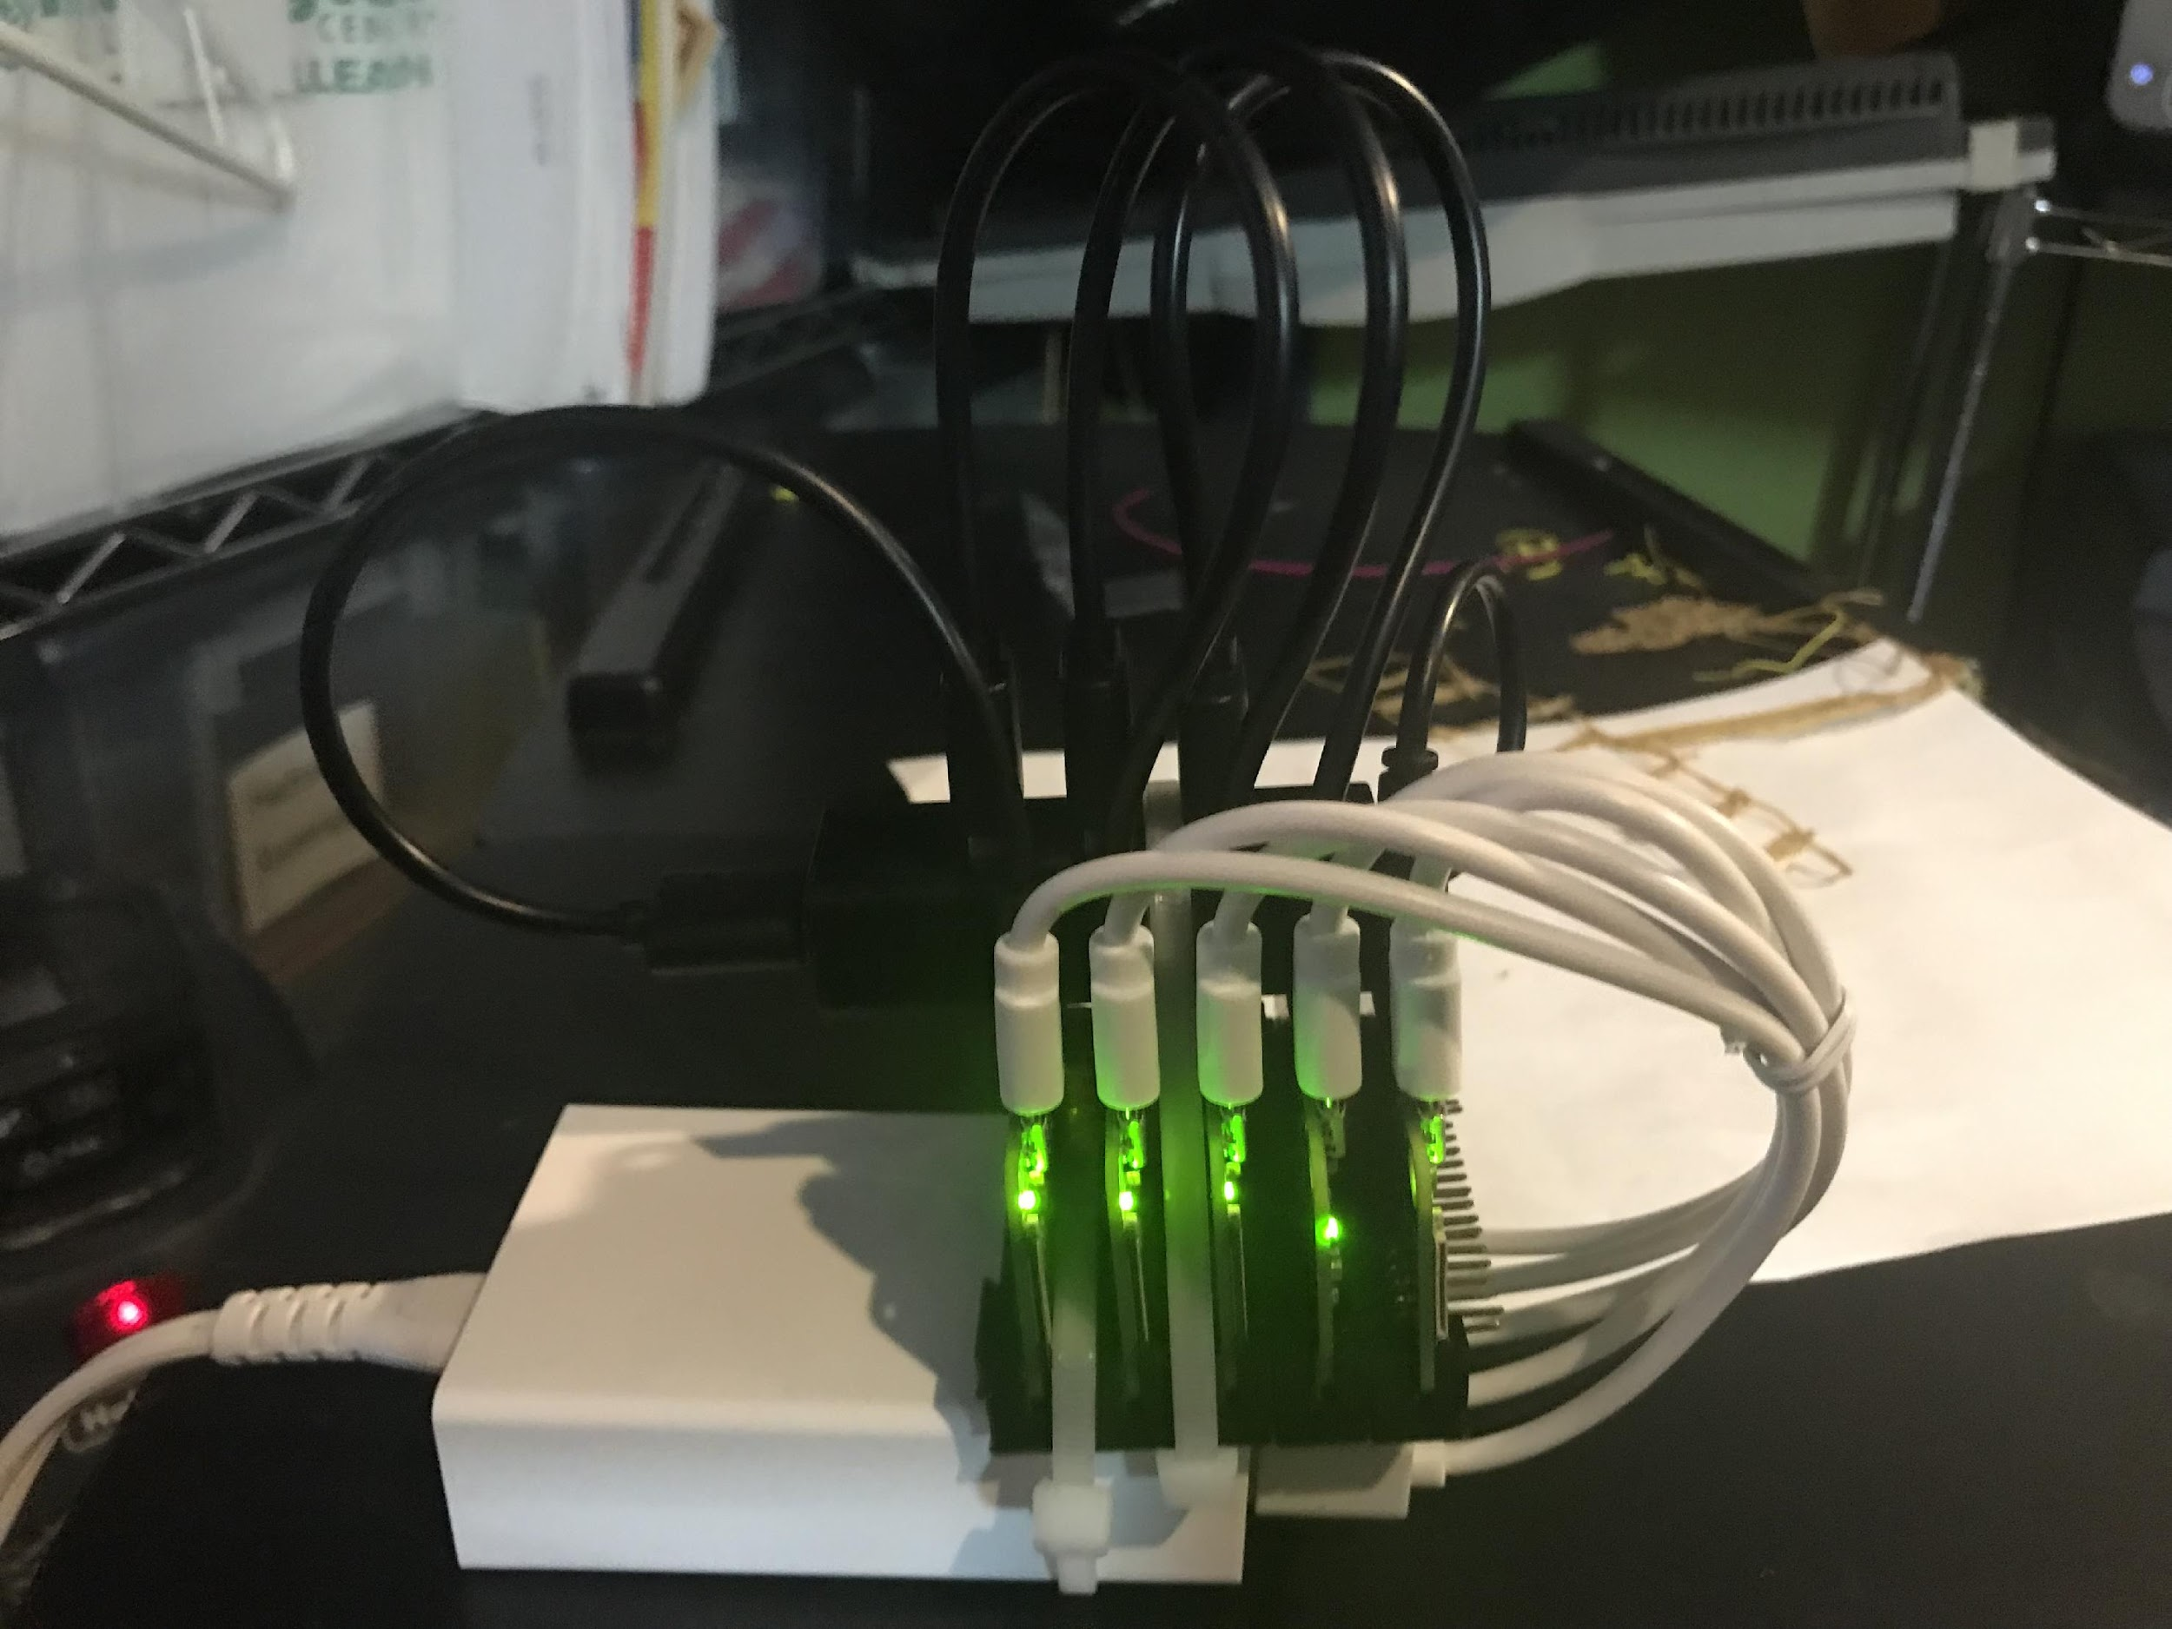
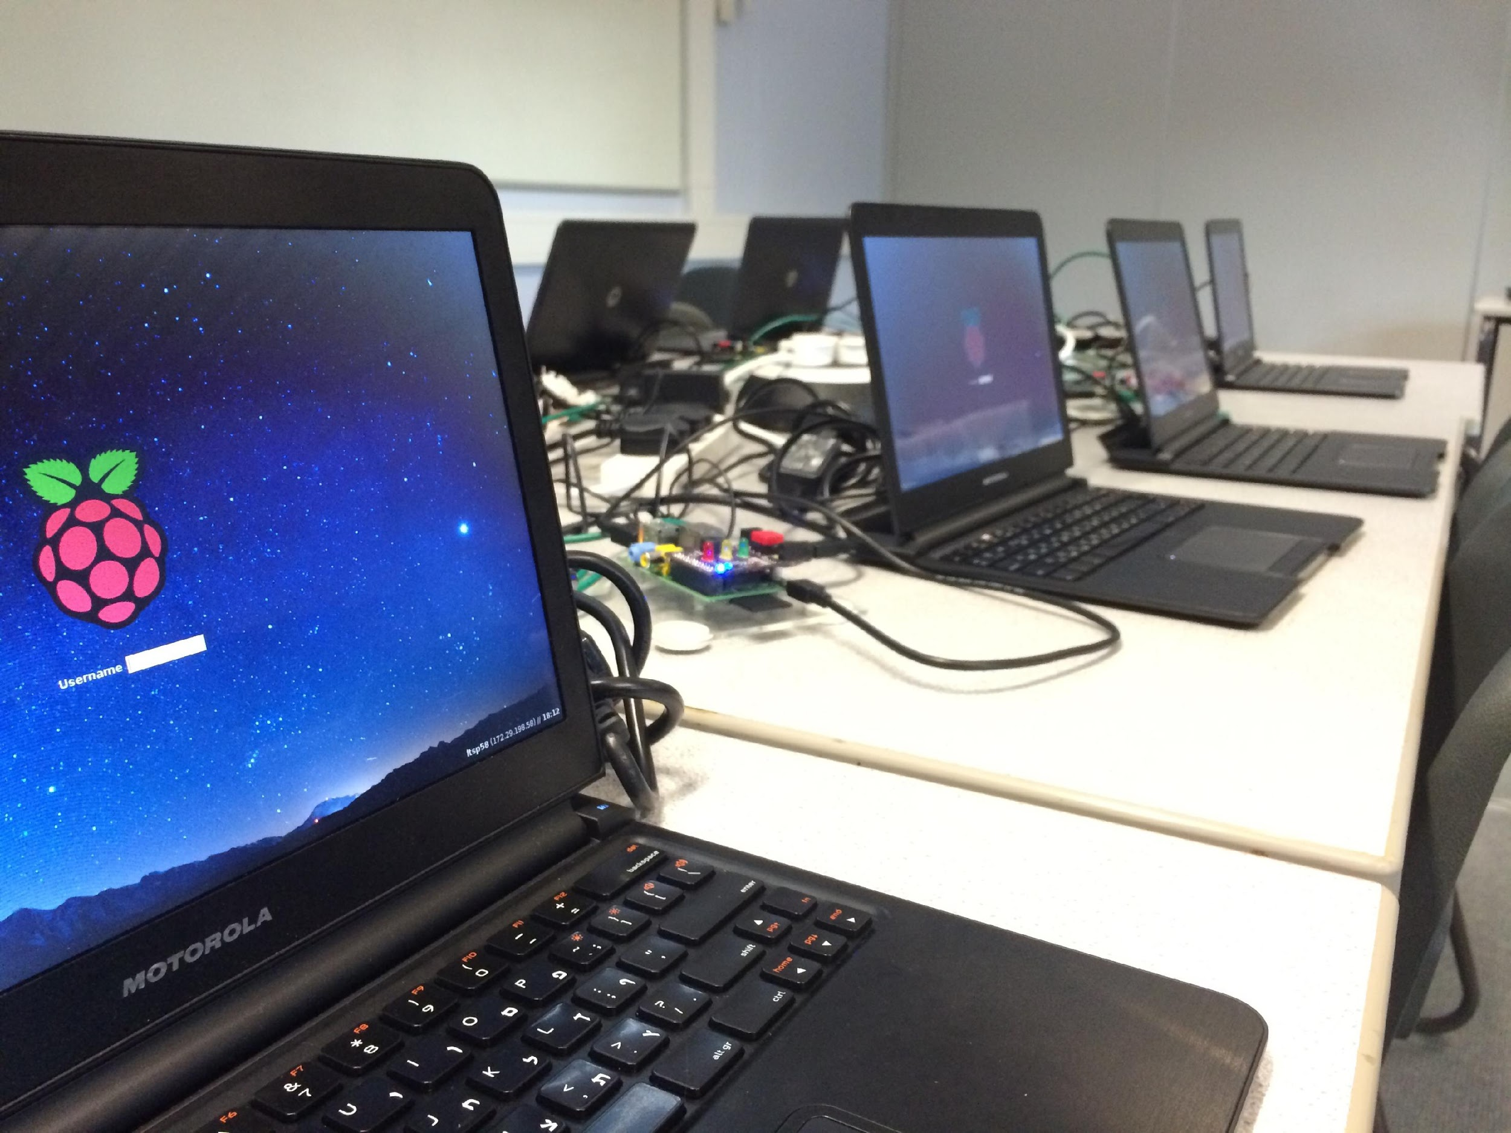
$ whoami
Notes:
‹#›

Slide 4
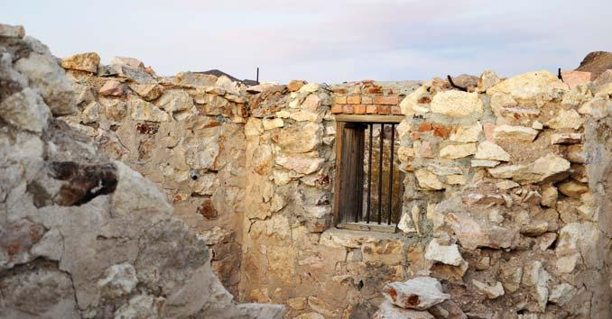
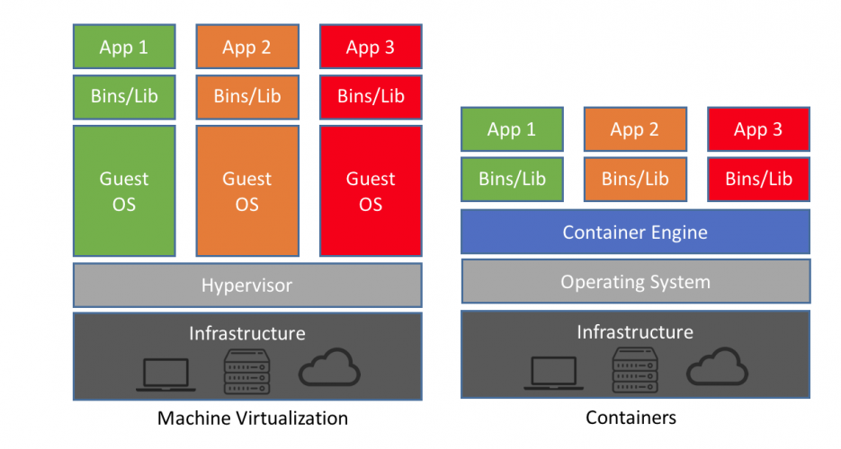


Quick Primer
Process isolation tech is old!
Remember “chroot”? (circa 1982)
Used commonly in build systems and honeypots
2005 Sun “Solaris Containers”
2008’ish LXC and later “Docker”
“Containers” or more specifically container runtimes are NOT virtualization.
Resource waste reduction (virtual hardware)
Containers “share” host resources (Kernel)
Container runtime interaction / orchestration is based on
Declarative descriptions making it much easier for developers to “spin up” their own resources (may be good, may be bad!)
It’s a “Jail” ~ Bill Cheswick
Virtualization
Process isolation
a.k.a. Containers

Slide 5
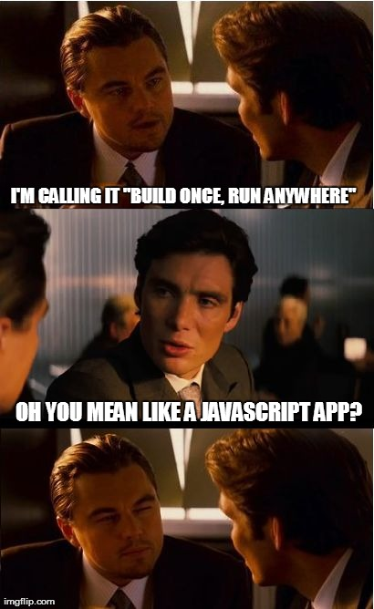
Why?, Why not!
Chroot was used extensively in the past to assist with build environments.
As kernel capabilities and protections got better, so did their adoption and use in the build process.
Eventually someone just asked the question “Why duplicate all the work?”
It’s cheap, personal dev. Stacks or team stacks.
Control dependency and “setup” hell.
docker-compose integration into your IDE
Reduce container image size
Use multi-stage builds
Use “FROM scratch” within Dockerfile “if you can”
Add “—no-install-recommends” to apt-get calls
Use reduction tools like “Docker-Slim”
Notes:
Why: should I consider containers over other tech (With specifics) We already have virtual machines what should we use this?
Tighter matching to the code.
Using only the resources needed to run the code produced. (lib’s dependencies)
Build once / run anywhere (you can run a container for the host arch)
Bottom line:
Single workload : use containers
Multiple workloads simultaneously: use virtualization.
Nobody said you cant use BOTH, Hyper-V
‹#›

Slide 6
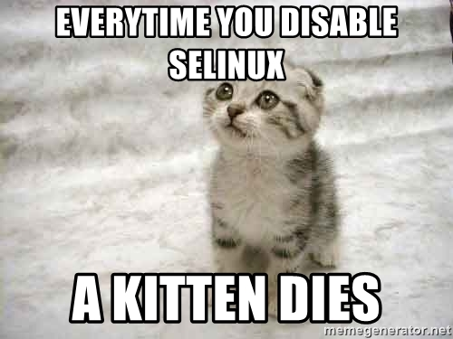
Start with a good host
Leverage existing hardening systems like:
TOMOYO
AppArmor (great doc’s on Docker site)
SELinux (Extensive documentation)
GRSEC
Networks
Avoid “--link”
Make use of “—icc=false” if the container isn’t hosting anything …
You can always force container processes to use exposed ports.
Use isolated networks or encrypted overlay networks if using multiple hosts
docker network create -d overlay --attachable my-attachable-overlay
Notes:
[Builder]
Chroot was used extensively in the past to assist with build environments.
Leveraging the additional capabilities of process isolation that have been added into the Kernel, Build architects started to
How: Leveraging containers to do the hard work / Demo (With specifics) I'll touch on automation, ease of use, orchestration, etc.
Demo buiuld/edit with commit, pull request and auto deploy
‹#›

Slide 7
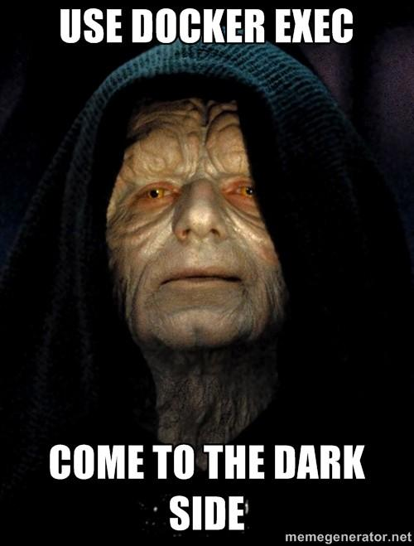
User context
Docker runs as root!! (non-root can access it but …)
Remap inner container users to non-root users
dockerd --userns-remap="testuser:testuser"
Support for the “--user” command is limited to “run”
CI/CD systems may need to augment there yaml via
bash wrapping. i.e. “${THIS_UID}”
THIS_UID=$(id -u):$(id -g) docker-compose up
Storage
Avoid using “--bind”
Use centralized (managed/backed up) storage drivers
“for the love of God no NFS, or NFSv4 if you have to”
Notes:
How: Can containers improve the security posture and how. / Demo (With specifics), attack surface reduction, scanning, kernel namespace, etc.
seccomp (short for secure computing mode) is a computer security facility in the Linux kernel. It was merged into the Linux kernel mainline in kernel version 2.6.12
The power of leveraging an orchestration platform (Rancher / Kubernetes / Swarm)
Cgroups
Seccomp
Namespaces
On Windows it’s
resource controls implemented by (Windows host compute service)
Hyper-v
Namespaces
https://github.com/docker/docker-bench-security
https://github.com/anchore/anchore-engine
https://github.com/coreos/clair#kubernetes
https://github.com/cilium/cilium
https://github.com/draios/falco/
#AppArmor profile generator for Docker containers
https://github.com/genuinetools/bane
https://github.com/docker-slim/docker-slim
https://blog.aquasec.com/windows-host-compute-service-shim-remote-code-execution-vulnerability-cve-2018-8115
‹#›

Slide 8
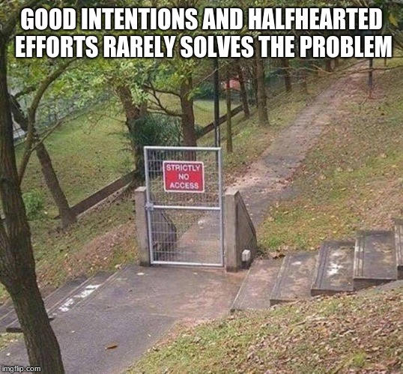
Security / Defense
Cgroups
control what a process can use.
Syscslls, (clone,unshare,setns)
Namespaces
control what a process can see.
UTS,NET,MNT,IPC (USER)
Seccomp
What you can “do”
Docker managed via profiles
--security-opt seccomp=deny.json
Kernel Capabillitys
--cap-drop=all --cap-add=SYS_TIME
Orchestration Security
(RBAC, segmentation, encryption)
Host Security
Remove ssh and local console
Containers are processes
born from tarballs,
anchored to namespaces;
controlled by cgroups!
~u/honghuac
Notes:
Common Attacks, misconfigurations, defaults, etc.
By using the “docker diff” command or the “docker history” command you could script analysis of how to
Place the “tmpfs” folders.
docker run –read-only --rm -it --name dvwa -p 8080:80 -v /etc:/var/www/html/etc vulnerables/web-dvwa
Just how powerful “—read-only” flag is
<Click>
Just how frustrating this same flag is
DEMO
$ while :; do test $(docker diff node-hack | wc -l) -gt 0 && docker kill node-hack; sleep 3; done
# in a different terminal:
$ while :; do docker run -it --rm -p 1337:1337 --name node-hack jerbi/node-hack; sleep 2; done
Rinse, repeat
Credential steeling / reuse
Poisoned containers
Miss configuration
https://github.com/ttimasdf/docker-cve-search. (offline cve search)
Jay Beal
https://www.youtube.com/watch?v=fZJ-5rAwcp0
Use docker to experiment with new exploits.
https://github.com/Semmle/SecurityExploits
https://libs.garden/docker/similar/vulhub/vulhub
‹#›

Slide 9
Cgroups (Control Groups)
Docker resource flags like “--cpus” or “--memory”
docker run -it --rm --cpus="1" busybox
Doesn't always work! (only if one container per host)
/ # cat /sys/fs/cgroup/cpu/cpu.cfs_quota_us
Docker’s “backup plan” the “—cgroup-parent” option
docker run -it --rm --cgroup-parent=/cgroup-limit/ <<image-name>>
/ # cgcreate -g cpu:cgroup-limit / # echo 100000 > /sys/fs/cgroup/cpu/cigroup-lmit/cpu.cfs_quota_us / # echo 100000 > /sys/fs/cgroup/cpu/cgroup-limit/cpu.cfs_period_us
Notes:
Less Common Attacks / Demo, privilege escalation, service account reuse, etc.
Bust-a-kube
Compromise Container
mount | grep –I kubernetes
ls /run/secrets/kubernetes.io/serviceaccount
Should see
ca.crt
namespace (which namespace am I in)
token
Upload “kubectl”
kubectl –token=`cat /run/secrets/kubernetes.io/serviceaccount/token` --certificate-authority=/run/secrets/kubernetes.io/serviceaccount/ca.crt –server=https://`echo $KUBERNETES_SERVICE_HOST`:`echo $KUBERNETES_SERVICE_PORT`
kubectl auth can-i exec pods
‹#›

Slide 10
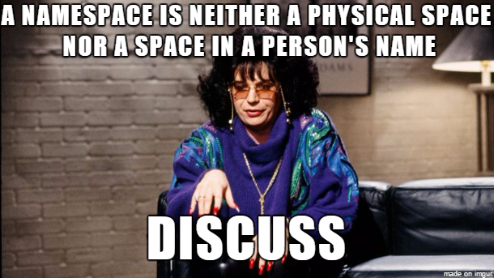
Namespaces
Kernel enforced user space views.
Peer
UTS – No really “this is your hostname
NET - Docker using this to allow C-2-C and C-2-H IP
communication. (own stack, routing etc. i.e. veth)
MNT - used to manage filesystem mount points.
IPC - Widely unused by anyone. “--ipc private”
Hierarchies:
PID - Docker makes use of this to setup the inner process tree, i.e. starting at PID # 1 etc.
User - Docker allows you to map or re-map inner container users to “NODE” or “HOST” users.
Cgroups - Designed to “hide” system limits / limitations.
Notes:
Top 5’s
Builder:
Reduce Dependencies
2. Run the C.I.S. benchmarks on your container env.
(don’t get stuck when your images won’t run in prod)
3. Add HEALTHCHECK inside your images
4.
5.
Defender:
1. Curate container images (Vuln. Scanning) (set them up for your developers)
2. Require and Audit log outputs (centralized)
3. Maintain Realtime visibility of you container env.
4. Run the C.I.S. benchmarks on your container env.
5.
Breaker:
Start building a curated list of sites with ”DockerFiles”
Setup to test vulnerabilities.
2. Start digging into the communications between orchestration systems and container runtimes.
3. Brush up on your kernel exploitation techniques.
4.
5.
‹#›

Slide 11

Seccomp (Secure computing mode)
As stated this is currently a Linux only technology.
If you wanted to achieve a similar technique on windows you would have to make use on EMET and HIPS.
Kernel dependent. (>= 2.6.29) armv6,7,8 too ☺
Must be compiled in.
$ grep CONFIG_SECCOMP= /boot/config-$(uname -r)
Look for:
CONFIG_SECCOMP=y
CONFIG_SECCOMP_FILTER=y
On a 64bit system there are something like 548 syscalls
There are 306 syscall filters in the docker “default” BPF profile.
Beware: --security-opt seccomp=unconfined
So how do we create a policy for system calls?
Manually create the policy (Guess)
Leverage existing tools
https://github.com/david942j/seccomp-tools
https://github.com/docker-slim/docker-slim

Slide 12
Great Advice
N.I.S.T. 800-190 (April 10 2017)
Docker C.I.S. (docker-bench-security) [ https://github.com/docker/docker-bench-security ]
Kubernetes C.I.S. (kube-bench) [ https://github.com/aquasecurity/kube-bench ]
Use a runtime security / monitoring framework
Falco / anchore Twistlock / Aqua
Privately store and continuously scan your container images. (Registry)
Sonatype (Nexus OSS) / Jfrog (Artifactory)
“--read-only” if you can “get away with it”
Notes:
This years theme of Kernelcon is “origin story”
What all these different disciplines thought me …
Patience
Forgiveness
Compassion
‹#›

Slide 13
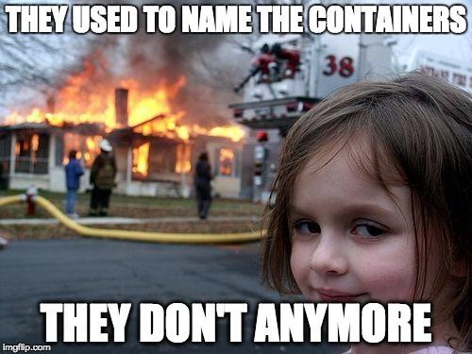
CVE-2019-5736
--userns-remap
Common Attacks
Misconfigurations
--privileged AND --security-opt label=disable
host insecure, container runtims run as root
Defaults
Doing nothing, not protecting endpoints
”I use StackOverflow as my RunBook” ☺
Ignorance
Not checking source images (poisoned images) [Think BitTorrent or Warez for dev’s]

Slide 14

Less Common Attacks:
Orchestration leverage
Improper RBAC
Kernel vulnerabilities
Exercises, a little later
today

Slide 15
(Where do we go from here?)
Builder:
Reduce Dependencies
2. Run the C.I.S. benchmarks on your container env.
(don’t get stuck when your images won’t run in prod)
3. Add HEALTHCHECK inside your images
Breaker:
Start building a curated list of sites with ”DockerFiles”
Setup to test vulnerabilities.
2. Start digging into the communications between orchestration
systems and container runtimes.
3. Brush up on your kernel exploitation techniques.
Defender:
1. Curate container images (Vuln. Scanning) (set them up for your developers)
2. Require and Audit log outputs (centralized)
3. Maintain Realtime visibility of you container env.
4. Run the C.I.S. benchmarks on your container env.
Notes:
CGROUPS
Kernel Capabilities
‹#›

Slide 16
Simple Container Forensics: (Docker specific)
By leveraging a few docker commands you can do some rudimentary forensics.
Docker diff –h
Docker history -h
docker run -it --rm –p 1337 --name node-hack jerbi/node-hack
docker network disconnect demo6_default demo6_node-hack_1
docker export --output=”hacked_site.tar" demo6_node-hack_1
docker diff demo6_node-hack_1
Notes:
Namespaces
On Windows it’s
resource controls implemented by (Windows host compute service)
Hyper-v
‹#›

